Slide 1
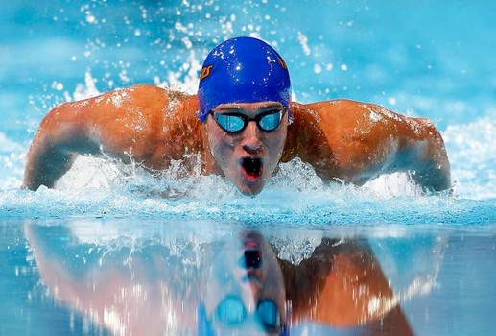
What is ‘fast’ and ‘slow’ metabolism?
Metabolic Diseases Lesson 3.2

Slide 2
Do Now
What is the difference between a ‘fast’ and a ‘slow’ metabolism?
Why do men usually need more calories than women?
Can you change your metabolism?

Slide 3
Extreme metabolic needs!
Michael Phelps
Needs 12,000 calories a day!

Slide 4
Our metabolic rate depends on two major uses of energy
Resting or basal metabolic rate (BMR)
Energy used for physical activity

Slide 5
Activity:
Unit 3.2 worksheet:
Calculating basal metabolic rate (BMR)

Slide 6
Discuss your findings with the class!
What is the difference between ‘fast’ and ‘slow’ metabolism?
Are there other factors that may contribute to metabolic rate?

Slide 7
Other factors that may contribute to metabolic rate
Hyper or Hypothyroidism
Genetics that influence muscle mass
Calorie absorption
Brown vs White fat

Slide 8
Other factors that may contribute to metabolic rate
Hyper or Hypothyroidism
Genetics that influence muscle mass
Calorie absorption
Not well understood - but not all foods are absorbed equally and some people may absorb food better than others. May have to do with our microbiome.
Notes:
Define microbiome

Slide 9
Other factors that may contribute to metabolic rate
Hyper or Hypothyroidism
Genetics that influence muscle mass
Calorie absorption
Brown vs White fat
Brown fat has a mitochondrial uncoupler that allows protons to flow down their energy gradient releasing heat. More brown fat results in more calories being used.
Notes:
Recall from the Lesson 2.2 case study that brown fat is a form of adipose found in newborn babies and in people that live in cold climates.

Slide 10
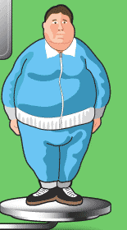
Wrap Up
Remember Bob? How does his metabolic rate relate to his obesity?
Trick question… A person’s metabolic rate DOES NOT LEAD to obesity.
Rather, obesity happens when one’s caloric intake does not match metabolic requirements
Probably slower than Bill’s because he lacks Bill’s muscle mass

Slide 11
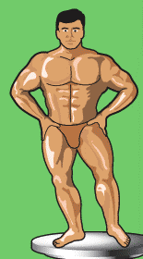
Wrap Up
How about Bill? How does his metabolic rate relate to his obesity?

Slide 12
Wrap Up
Would you predict that Bob and Bill are eating the same number of calories?

Slide 13
Homework
Complete the worksheet
Write a paragraph explaining the relationship between an individual’s metabolic rate and obesity

